Slide 1
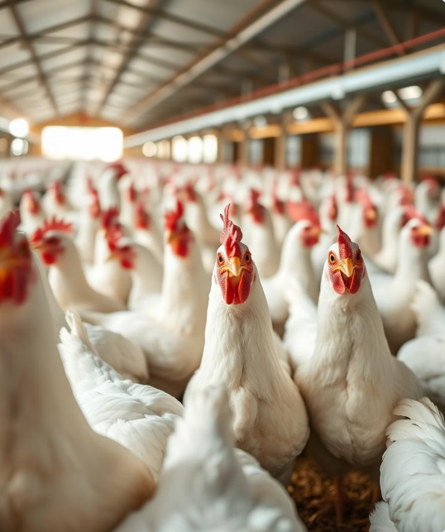
Transfer Learning Based Classification of Poultry Disease for Enhanced Health
Presented by:Bogala Pallavi
Appinedi Harshini
Anumukonda Varshini Priya
Anagani Chandana Sai
Tools & Technologies: Python, TensorFlow, Keras, OpenCV, ResNet50, VGG16
Domain: Deep Learning, Image Classification, Agriculture Tech

Slide 2
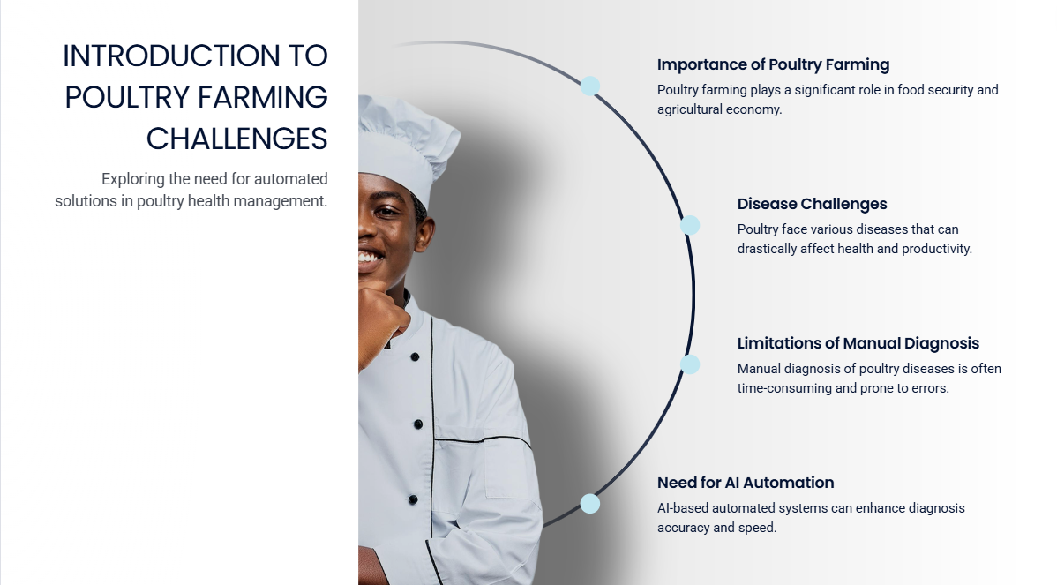

Slide 3
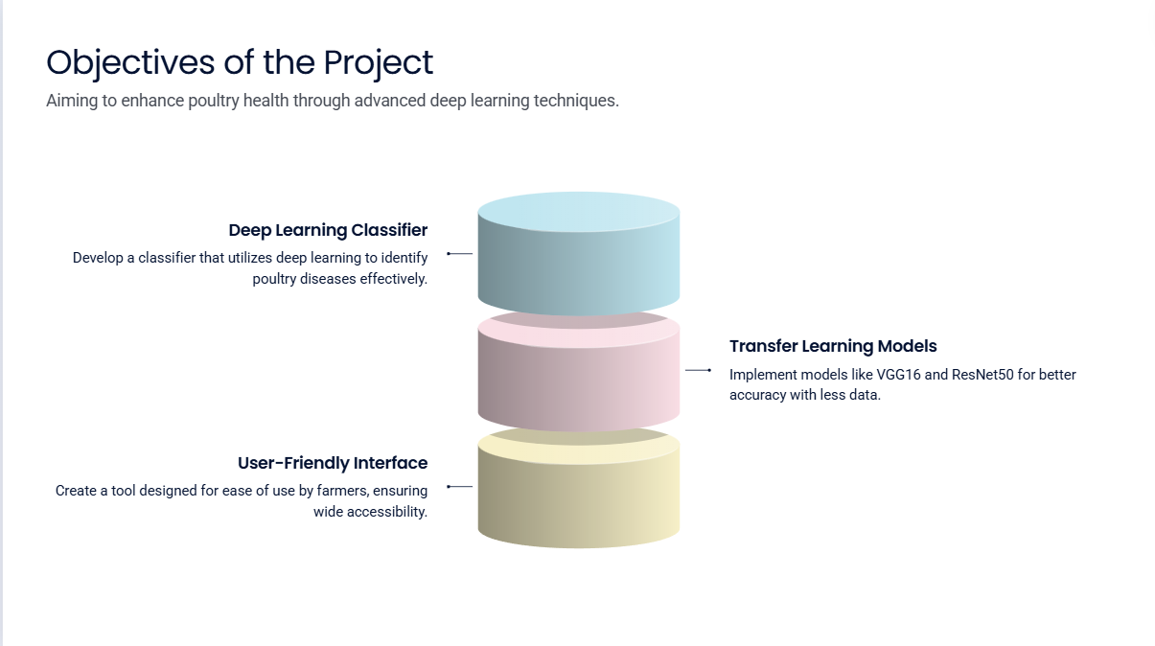

Slide 4
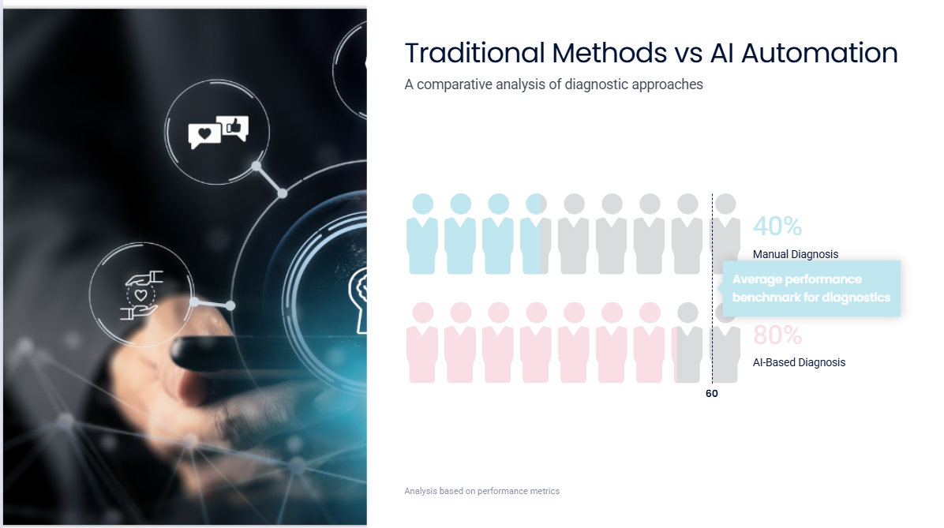

Slide 5
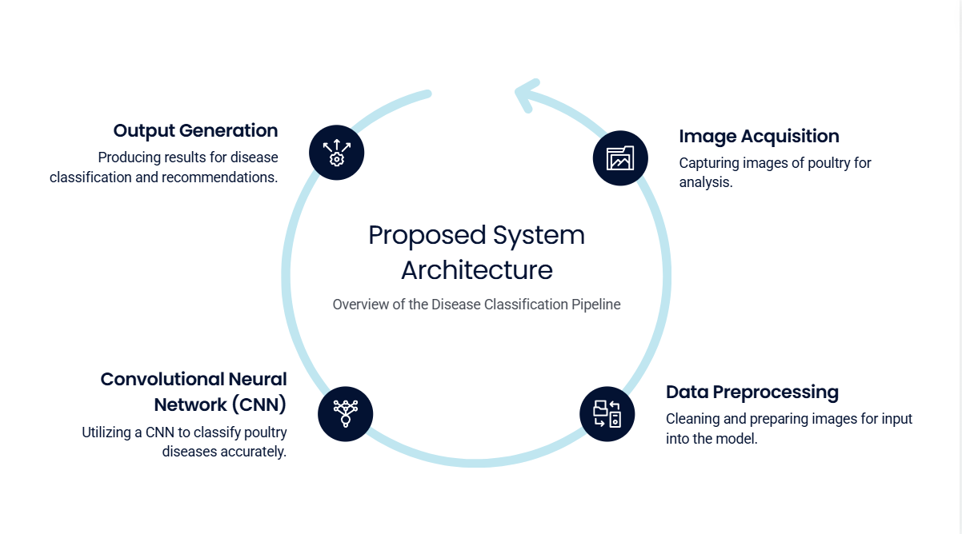

Slide 6


Slide 7
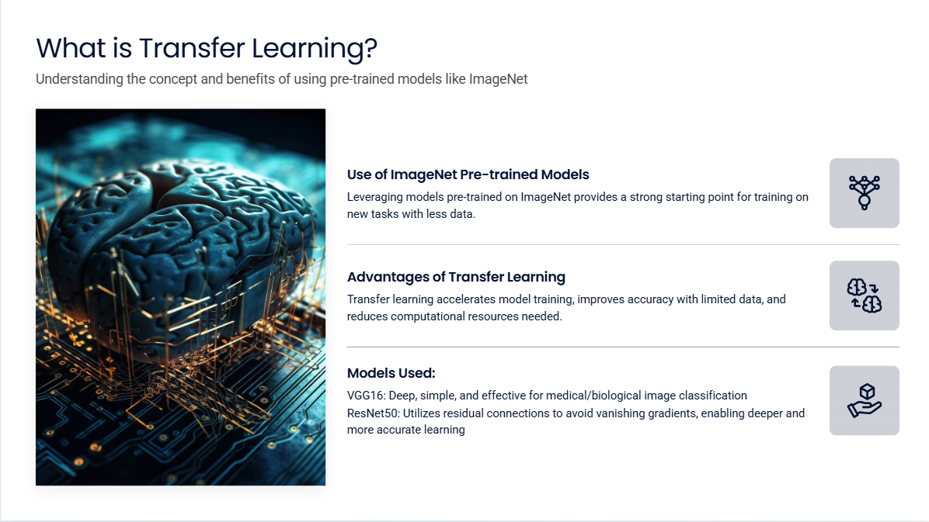

Slide 8
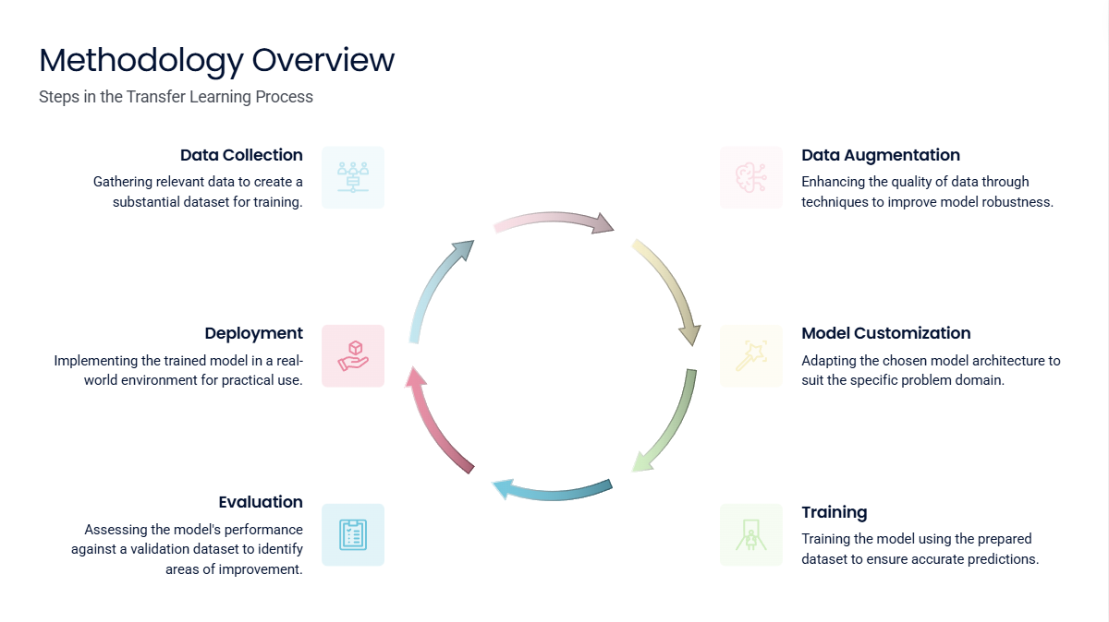

Slide 9
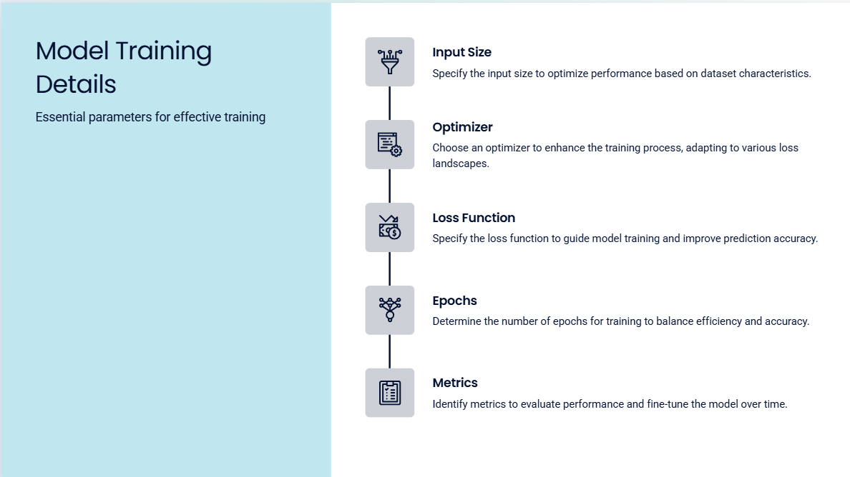

Slide 10
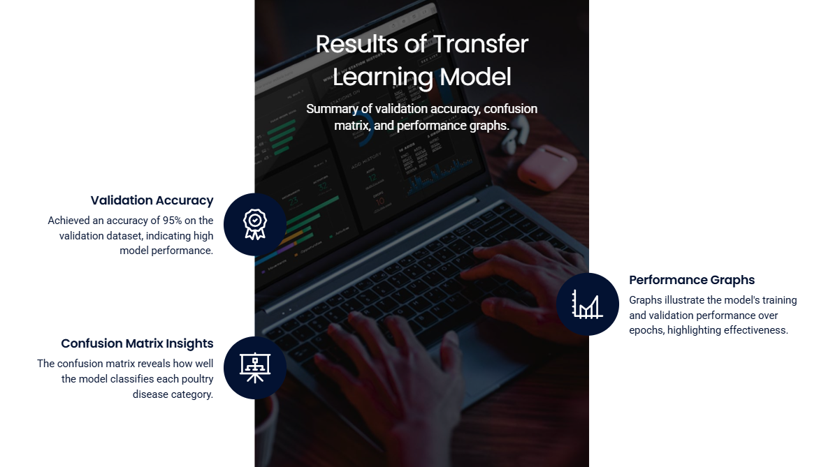

Slide 11
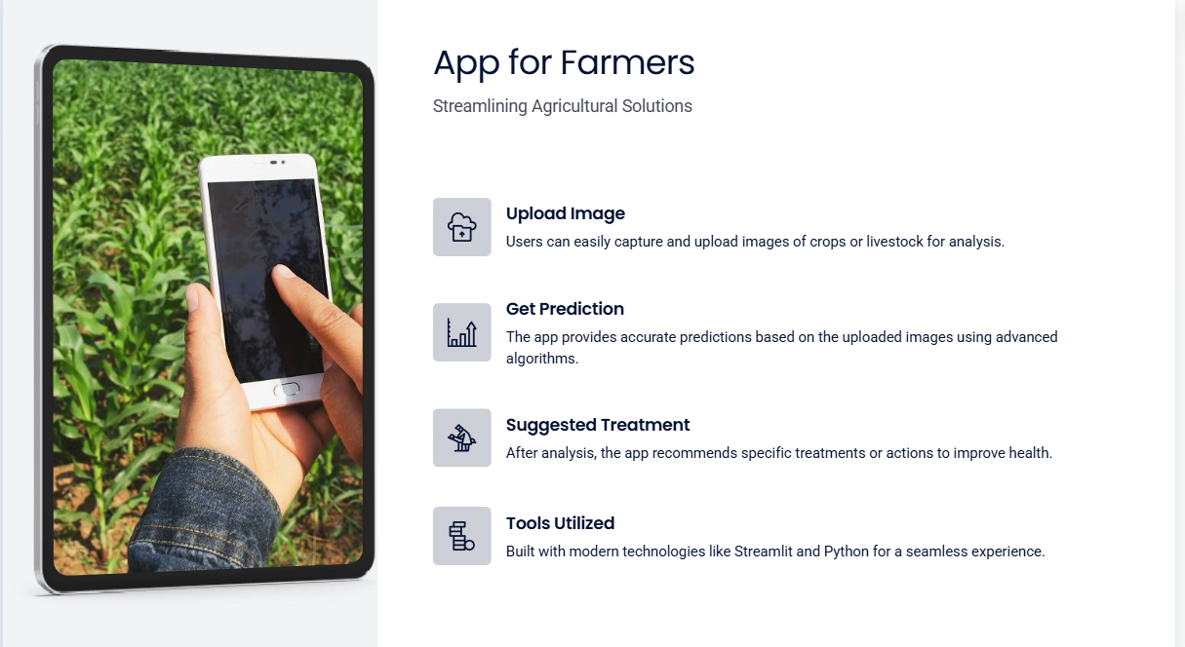

Slide 12
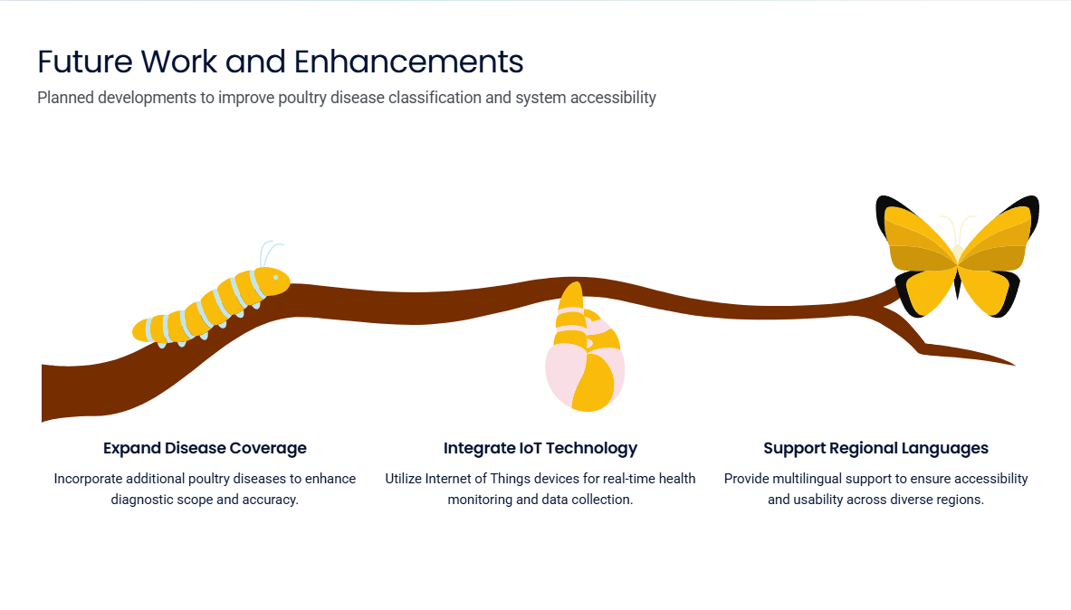

Slide 13
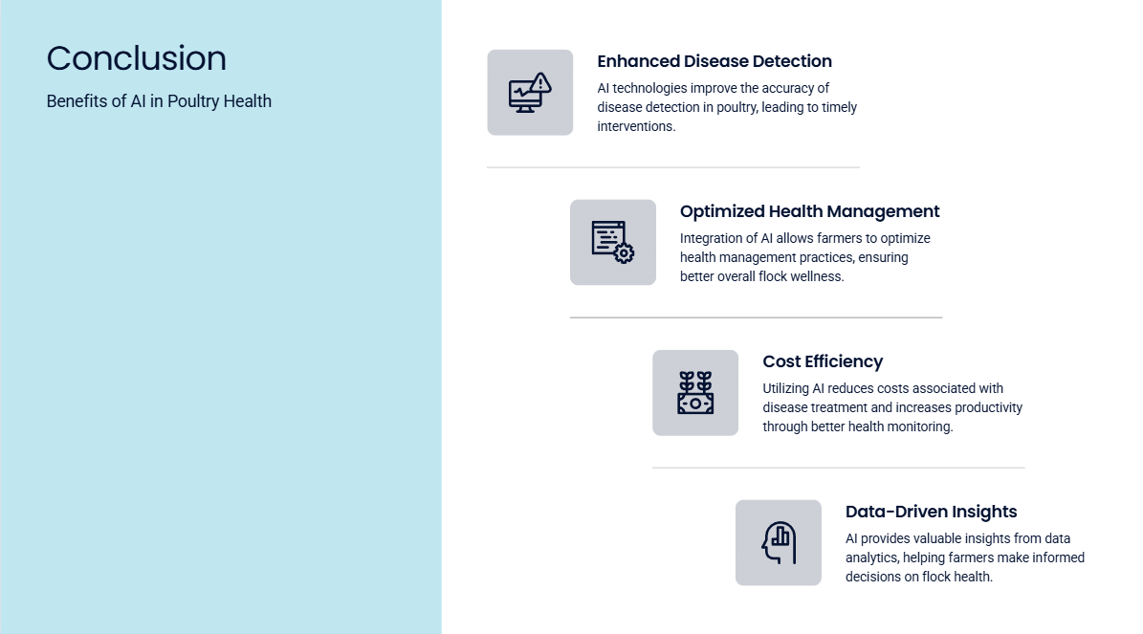

Slide 14
